Slide 1
Azure Intro
Wai Man Hui
Cloud Solution Architect

Slide 2
Why Azure?
Migration
Modernization
Enterprise-grade Infrastructure for less
Innovate faster with a fully managed platform
Protect your most valuable assets with trusted cloud security
Move on your terms with hybrid flexibility
Move with confidence with the
Azure Migration and Modernization Program

Slide 3
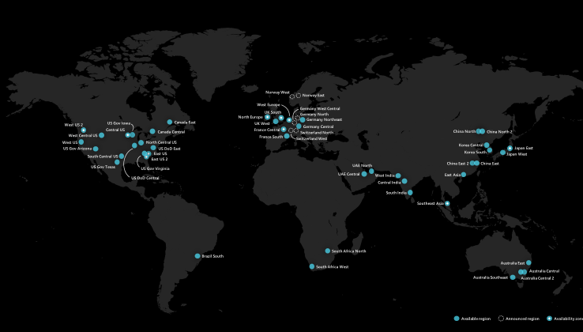

Global
Secure
Compliant
100+
Compliance offerings
GLOBAL
INDUSTRY
REGIONAL
ISO 27001:2013
ISO 27017:2015
ISO 27018:2014
ISO 22301:2012
ISO 9001:2015
ISO 20000-1:2011
SOC 1 Type 2
SOC 2 Type 2
SOC 3
CIS Benchmark
CSA STAR Certification
CSA STAR Attestation
CSA STAR Self-Assessment
WCAG 2.0 (ISO 40500:2012)
PCI DSS Level 1
GLBA (US)
FFIEC (US)
Shared Assessments (US)
SEC 17a-4 (US)
CFTC 1.31 (US)
FINRA 4511 (US)
SOX (US)
23 NYCRR 500 (US)
OSFI (Canada)
FCA + PRA (UK)
APRA (Australia)
FINMA (Switzerland)
FSA (Denmark)
RBI + IRDAI (India)
MAS + ABS (Singapore)
NBB + FSMA (Belgium)
AFM + DNB (Netherlands)
AMF + ACPR (France)
KNF (Poland)
European Banking Authority (EBA)
FISC (Japan)
HIPAA BAA (US)
HITRUST Certification
GxP (FDA 21 CFR Part 11)
MARS-E (US)
NHS IG Toolkit (UK)
NEN 7510:2011 (Netherlands)
FERPA (US)
CDSA
MPAA (US)
FACT (UK)
DPP (UK)
Argentina PDPA
Australia IRAP Unclassified
Australia IRAP PROTECTED
Canada Privacy Laws
China GB 18030:2005
China DJCP (MLPS) Level 3
China TRUCS / CCCPPF
EU EN 301 549
EU ENISA IAF
EU Model Clauses
EU – US Privacy Shield
GDPR
Germany C5
Germany IT-Grundschutz workbook
India MeitY
Japan CS Mark Gold
Japan My Number Act
Netherlands BIR 2012
New Zealand Gov CIO Framework
Singapore MTCS Level 3
Spain ENS High
Spain DPA
UK Cyber Essentials Plus
UK G-Cloud
UK PASF
60+
Microsoft Cyber Defense Operations Center
>3,500 full-time security professionals
6.5 trillion global signals daily
$1 billion annual cybersecurity investment
Azure regions
Largest geographical footprint of any cloud provider with more than 60+ Azure regions
U.S. GOVT
FedRAMP High
FedRAMP Moderate
EAR
ITAR
DoD DISA SRG Level 5
DoD DISA SRG Level 4
DoD DISA SRG Level 2
DFARS
DoE 10 CFR Part 810
NIST SP 800-171
NIST CSF
Section 508 VPATs
FIPS 140-2
CJIS
IRS 1075
CNSSI 1253

Slide 4
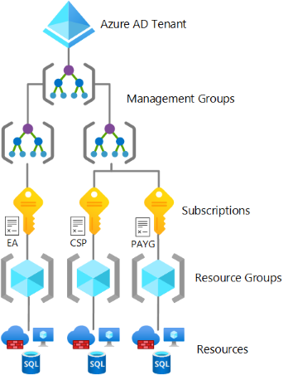
Azure Account Management
Subscription under the same Tenant can group to different management group for
The Azure service presents a range of active subscription offers, and customers can use these offers at the same time to gain flexible billing options.

Slide 5
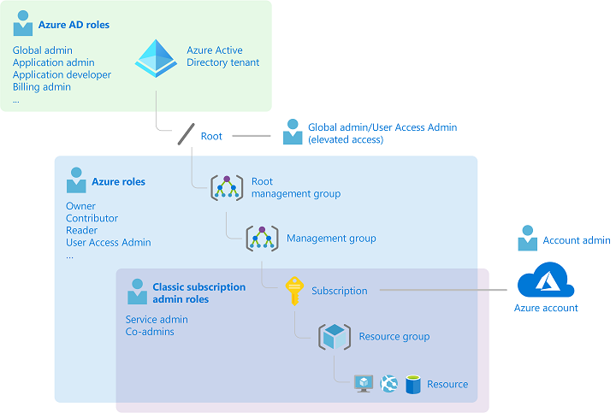
Azure Account Management
Azure AD provides full suite of identity management capabilities: MFA, RBAC, Security monitoring/ alerting, etc.
Azure AD Domain provides Group Policy and support different authentication protocols. (Kerberos and Azure AD Sync , Hybrid Identity Scenarios)
More AD Function & Features: Azure Active Directory Tier Comparison

Slide 6
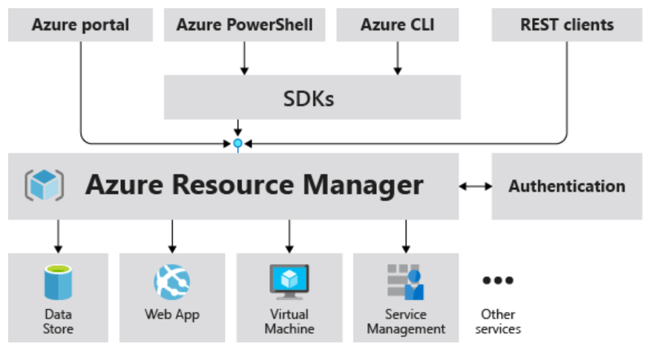
Azure Resource Manager
ARM is the main deployment and management service for Azure
Talks to various Azure Resource providers

Slide 7
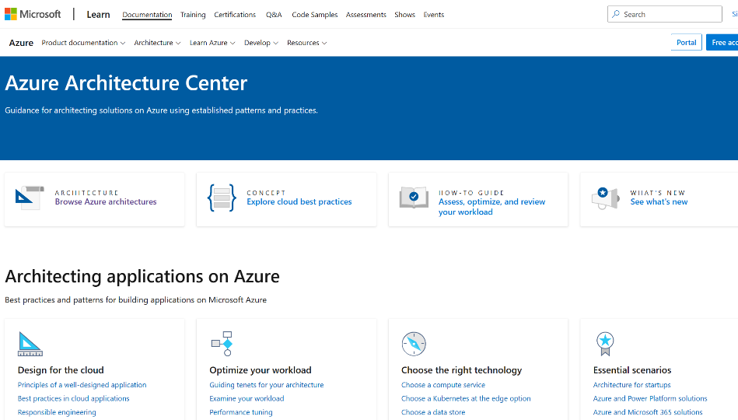
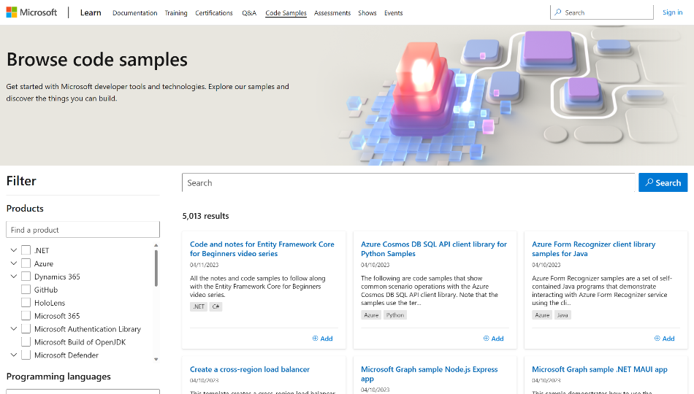
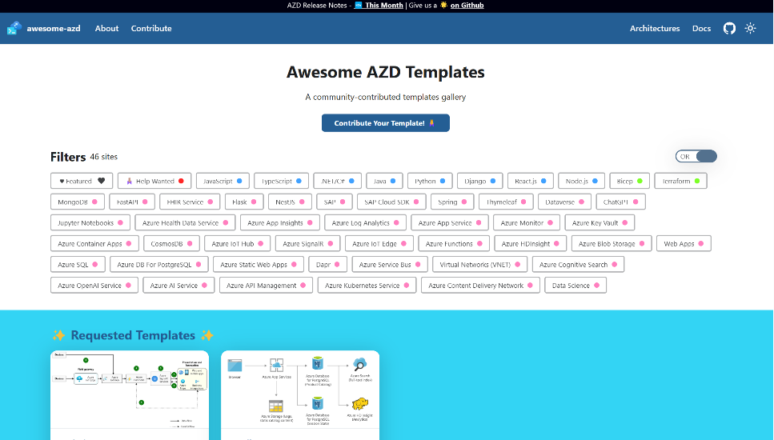
Resources
Azure Architecture Center
aka.ms/architecture
Best practices and patterns for building applications on Microsoft Azure
Code Sample
aka.ms/sample
Samples with code and step by step guide for getting start with Microsoft developer tools and technologies
Azure Developer CLI
aka.ms/azd
aka.ms/awesome-azd
Open-source tool with templates that accelerates the process of building cloud apps on Azure

Slide 8
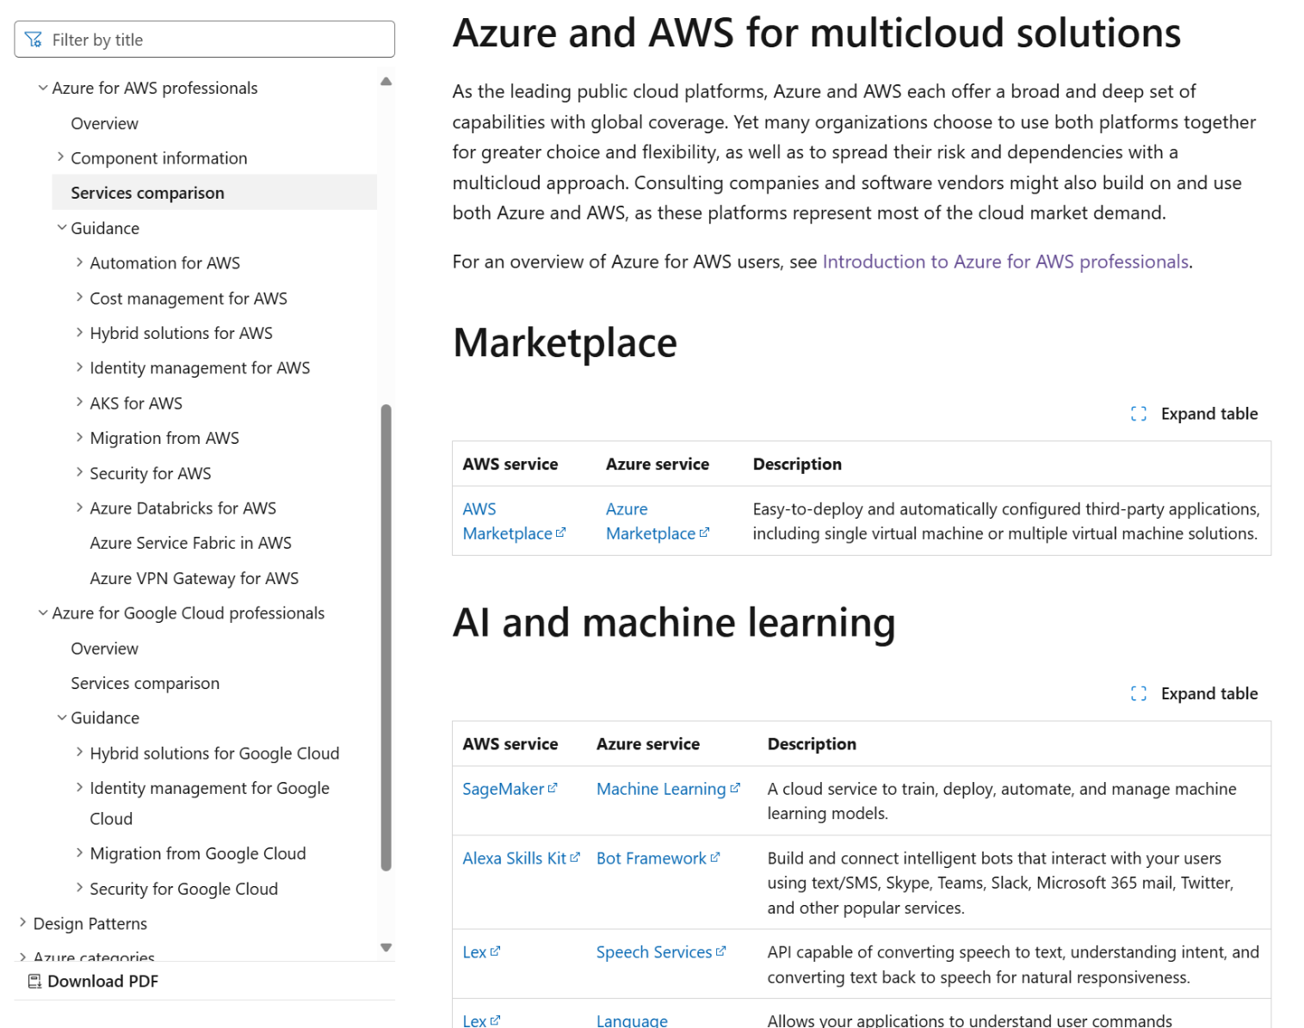
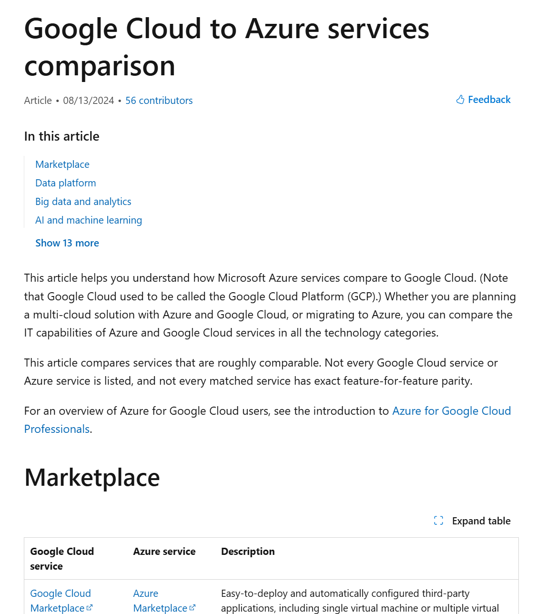
Documentation
https://learn.microsoft.com/en-us/azure/architecture/aws-professional/
https://learn.microsoft.com/en-us/azure/architecture/gcp-professional/

Slide 9
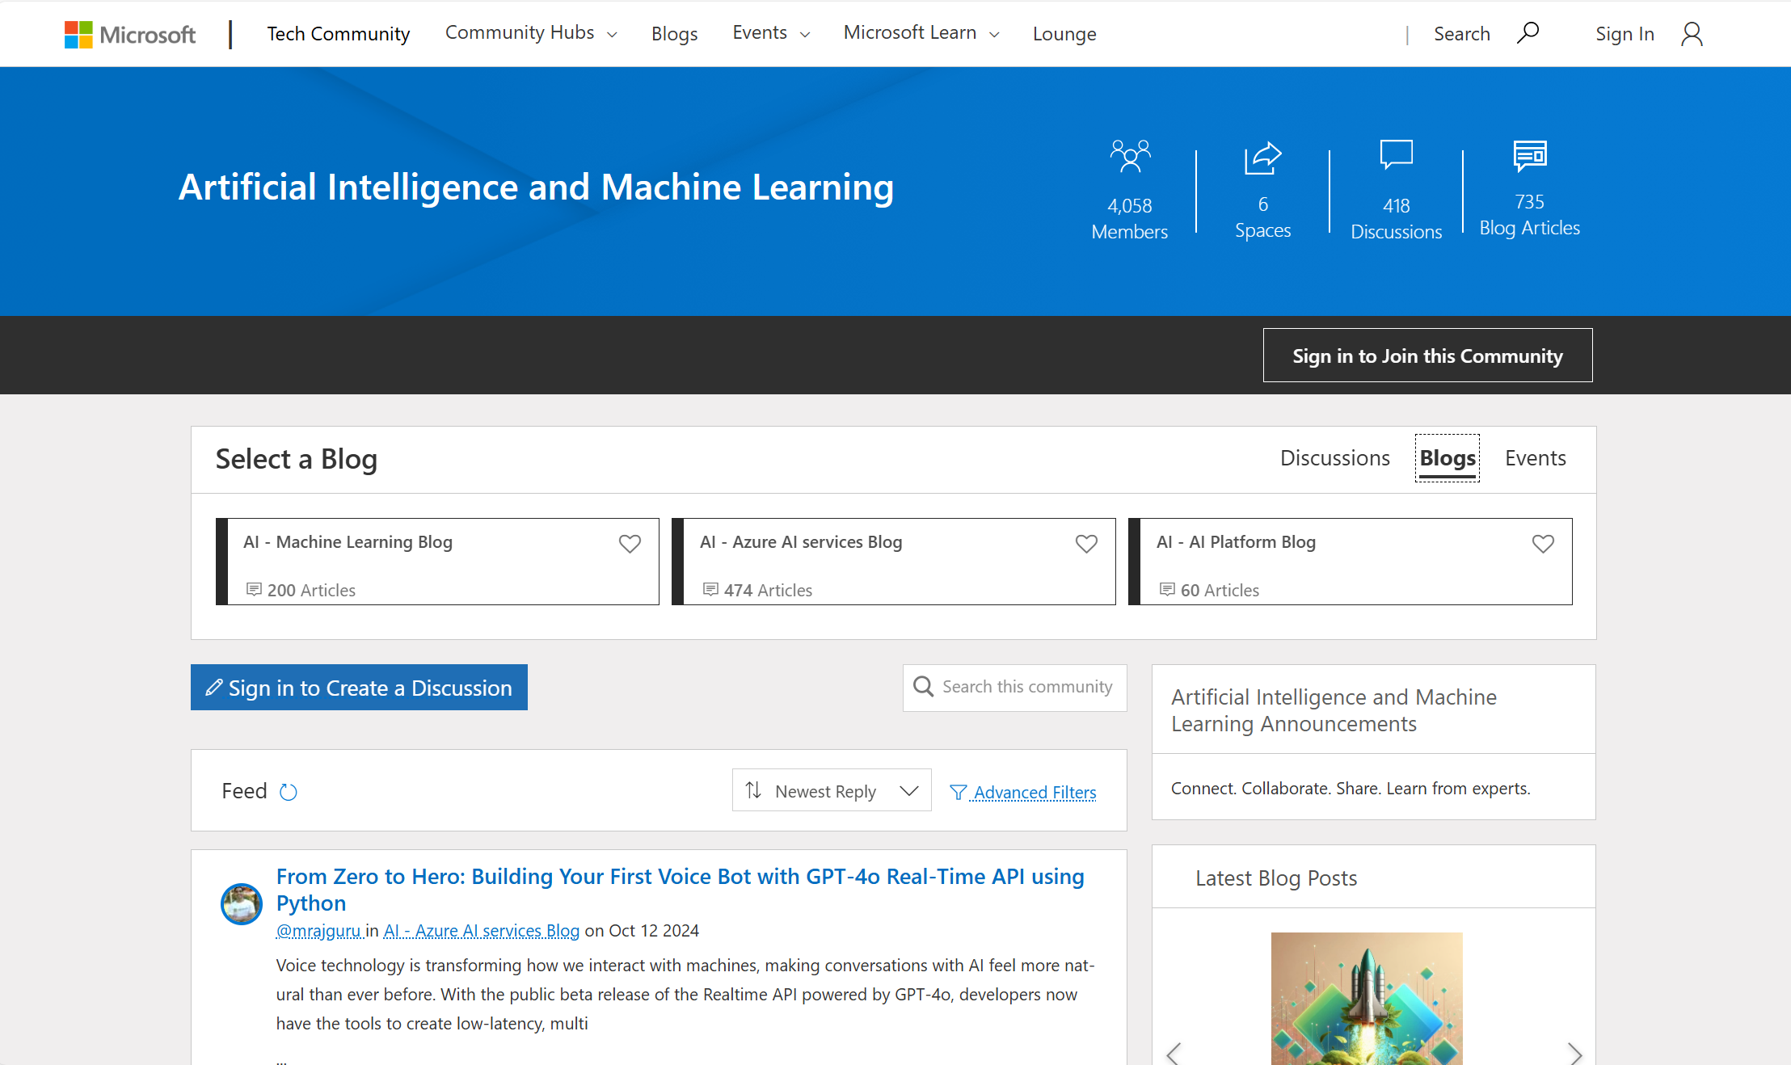
Tech Community Blogs
https://techcommunity.microsoft.com/t5/artificial-intelligence-and/ct-p/AI

Slide 10
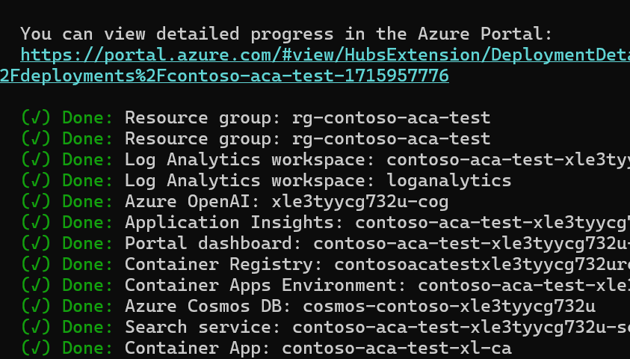
AI Project Templates with Azure Developer CLI (AZD)
Customer benefits
Quickly deploy applications with the command “azd up”
Common starter AI Scenarios to implement solutions
GitHub Actions for CI/CD deployment and evaluation to test model performance
The CLI allows you to work consistently in a repeatable way across the terminal, your editor/integrated development environment, GitHub Actions pipeline, and more.
https://aka.ms/azd-ai-templates

Slide 11

























Common App Modernization Services
Compute
VM
VM
Scale Set
Azure Kubernetes
Services(AKS)
Azure Red Hat
OpenShift (ARO)
Azure App Service
Azure Functions
Web
Container
Static Web App
Azure Communications Services
Web PubSub
Azure Container Instance
Web App for Containers
Container Apps
Container Registry
Integration
Logic Apps
Service Bus
API Management
Event Grid
Event Hub
Managed Databases
Azure SQL Database
Azure Database for
PostgreSQL
Azure Database for
MySQL
Azure Cache for
Redis
Azure Cosmos DB
Tools
Microsoft Playwright Testing
Azure Load Testing
Azure Managed Grafana
Azure DevOps Services
GitHub
Azure Monitor
Visual Studio Code

Slide 12














Azure application platform
Infrastructure focus, higher flexibility
Infrastructure abstraction, focus on application
Azure Container Instances
Azure Kubernetes Service
Azure Red Hat OpenShift
Azure Container Apps
Azure App Service
Azure Static Web Apps
Azure Functions
Optimized for
Single container
Build agents/ Special purpose platform
Containerized applications, APIs, and microservices
Windows and Linux based 3-tier web apps (code, container), API App
Web frontend apps / Single Page Apps (React, JAMstack)
Event-driven applications
Language affinity
Any language, any framework
.NET, Java, Python, Node.JS, PHP, Ruby
Angular, React, Svelte, Vue, Blazor
.NET, C#, Node.JS, TypeScript, Java, Python, PowerShell
Ecosystem affinity
CNCF
Red Hat
Microsoft
Microsoft
GCP and AWS competing services
AWS Fargate
Google Kubernetes Engine (GKE)
AWS Elastic Kubernetes Service (EKS)
Red Hat OpenShift on AWS (ROSA)
Google Cloud Run
AWS App Runner
Google App Engine
AWS Elastic Beanstalk
Google Firebase Hosting
AWS Amplify, S3
Google Functions
AWS Lambda
Microsoft Confidential

Slide 13
Azure containers portfolio
Infrastructure management
Serverless applications
Unopinionated
containers
Use the Kubernetes APIs to manage, deploy and scale the cluster in addition to application development
Platform handles the orchestration details with a focus on application development
Any container image, no restrictions
Azure Kubernetes Service
Azure
Container Apps
Azure Red Hat OpenShift
Azure
Container Instances
Opinionated
containers
Specific base image or programming model required
Azure App Service*
Azure Functions*
* When used with containers

Slide 14











Migrate apps to Azure
LOB Application Web and App tier (ASP.NET/Java web apps)
Azure Migrate Server migration
Azure laaS
Azure Migrate Web app migration
App Service
Azure Migrate App containerization
AKS

Slide 15
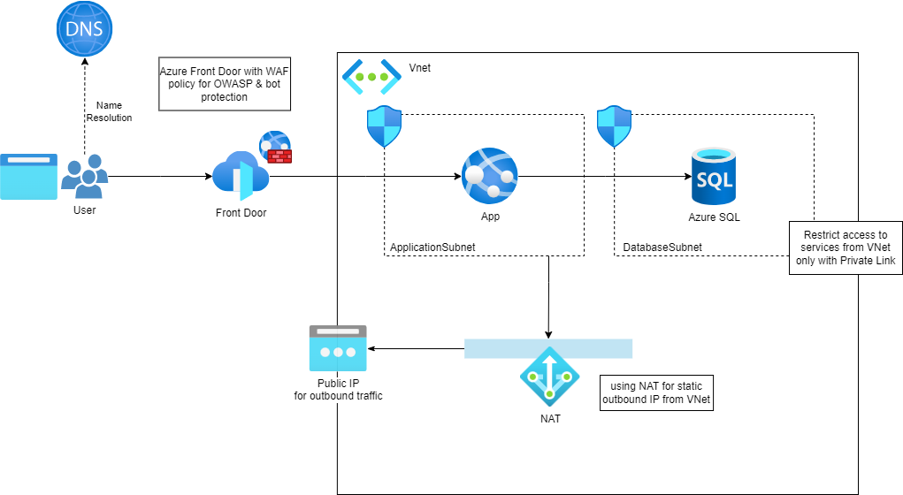
Basic Web Application Architecture on Azure

Slide 16





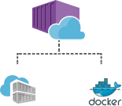





App Service Features
Azure App Service
Legacy On-prem Apps
Staging and deployment
App monitoring and diagnostics
High availability with auto patching
Backup and recovery
Global data center footprint
Testing in production
Auto scale and load balancing
Reduced operations costs
Security and compliance
AAD integration
App Migration Assistant
Azure Pipelines GitHub Actions Kudu
Code Deployment
Containerize
Azure Repos
GitHub
Dropbox
External Git mercurial
Visual studio
publishing

Slide 17
Web Application on App Service

Slide 18
Static Web hosting options
Traditional web app (ASP.NET, Express.js, Django) Azure App Service
All static content and want full control over setting up CDN, etc Static website hosting on Azure Storage
Turnkey service for building, deploying, running Jamstack apps Azure Static Web Apps

Slide 19
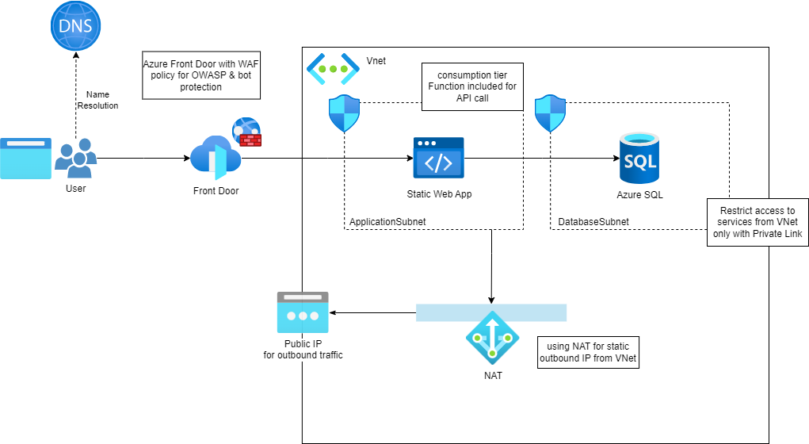
Application with Static Web App

Slide 20

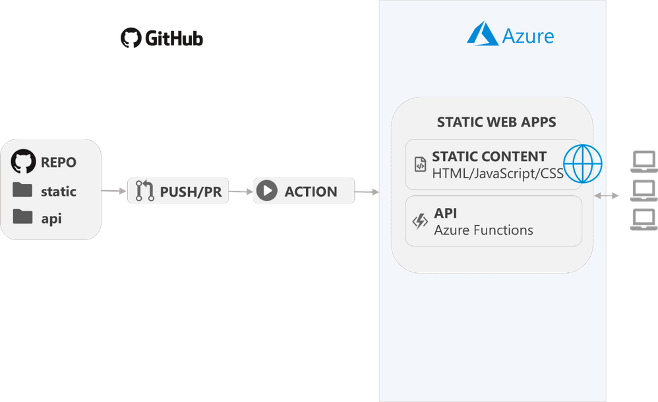





+
Azure Static Web Apps
Combine the power of static web apps with Azure Functions

Slide 21
Azure Static Web Apps Dedicated Plan: Building Enterprise Grade Full Stack Web Apps - Microsoft Community Hub
Static Web App
Public preview
 | Free | Standard | Dedicated
Web hosting | ✔ | ✔ | ✔
CI/CD | ✔ | ✔ | ✔
Global Distribution | ✔ | ✔
Custom Domain | 2 per app | 5 per app | 10 per app
Max app size | 250 MB per app | 500 MB per app | 2 GB
Private Link |  | ✔ | ✔
Managed Backends |  | ✔ | ✔
SLA |  | ✔ | ✔
Data Residency |  |  | ✔ Currently support Central US East US 2 East Asia West US 2
Always On Managed Functions Support |  |  | ✔
Select the Dedicated plan when:
Your application requires regional data residency.
Select Standard or Dedicated when:
Expected traffic volumes exceed bandwidth maximums.
The existing Azure Functions app you want to use either has triggers and bindings beyond HTTP endpoints, or can't be converted to a managed Functions app.
Security requirements that require a custom provider registration.
The site's web assets total file size exceed the storage maximums.
You require formal customer support.
You require more than three staging environments.

Slide 22
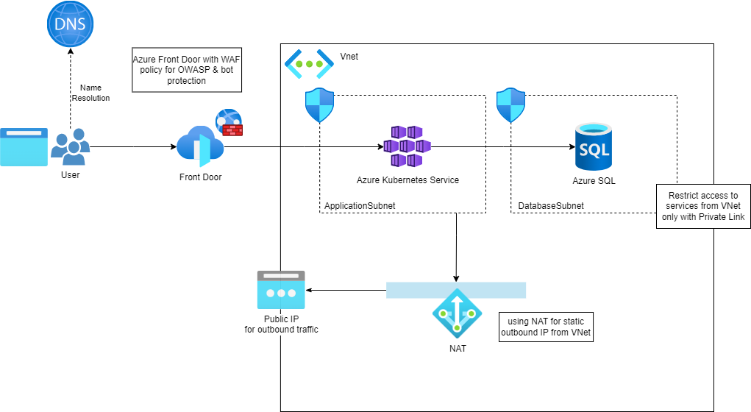
AKS with application gateway

Slide 23
Azure powers OpenAI/ChatGPT's innovation
ChatGPT
Runs on Azure Kubernetes Service
Backed by Azure Cosmos DB
Developed on GitHub
Fastest growing consumer product in history

Slide 24
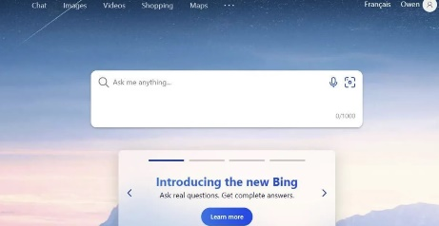
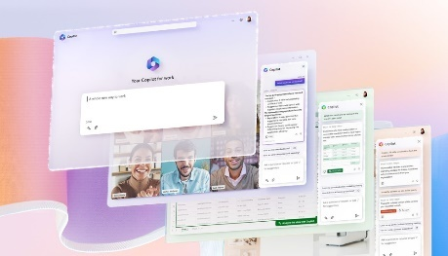
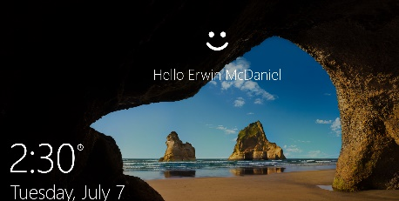
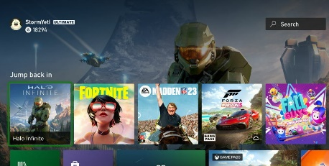
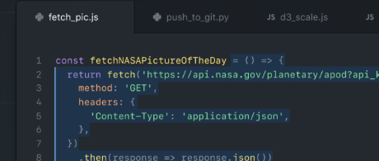
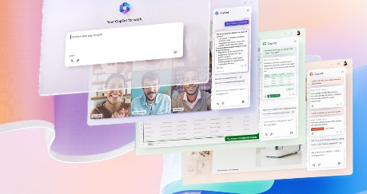
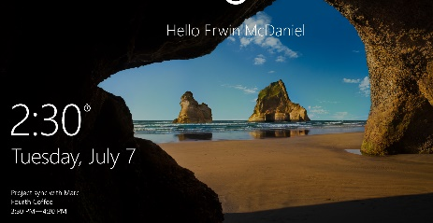
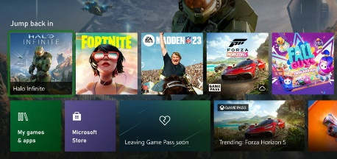
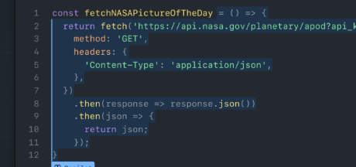






Microsoft uses the same services and tools for intelligent app innovation
AI-based search with ChatGPT
Copilot for Work across Office 365
Biometric identify verification
Personalized recommendations
Copilot assisted coding
Innovate on a pressure tested AI platform

Slide 25










AI Application Architecture Example 1
a
Resource Group
visualize
Azure Managed Prometheus
Azure Managed Grafana
scrape
https://learn.microsoft.com/azure/aks/open-ai-quickstart
OIDC Issuer URL
Azure Kubernetes Services
Namespace name
trust
Federated Credential
Microsoft Entra ID
Petstore Application
Managed Identity Client ID
env vars
ServiceAccount name
Managed Identity Principal ID
assign
Managed Identity Client ID
OpenAI
Cognitive Services OpenAI User
Managed Identity

Slide 26






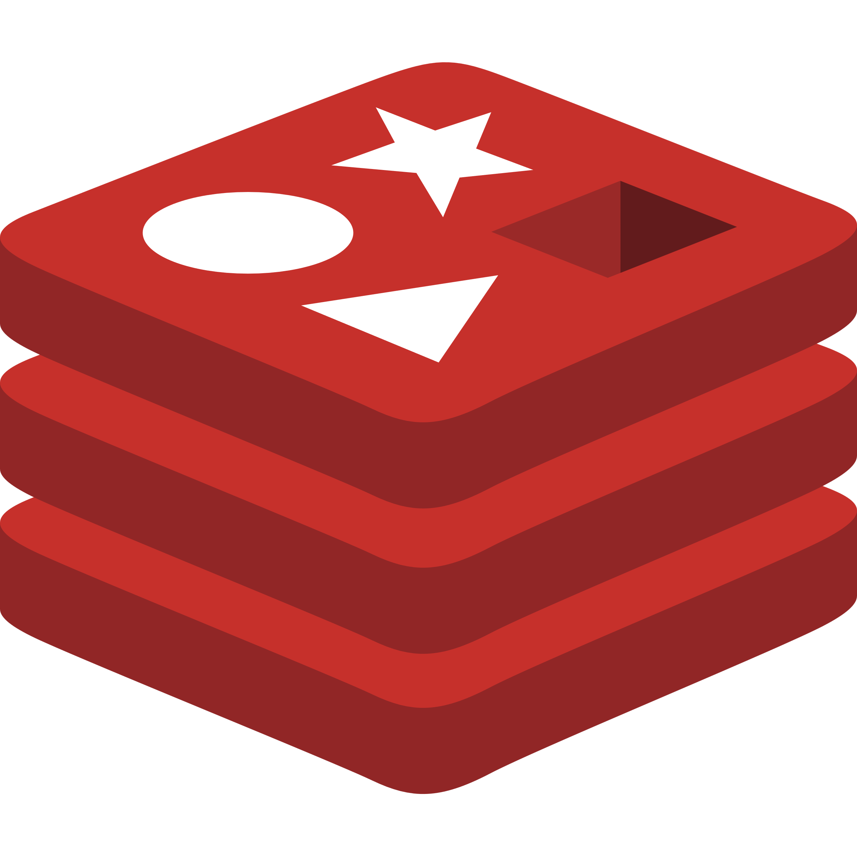
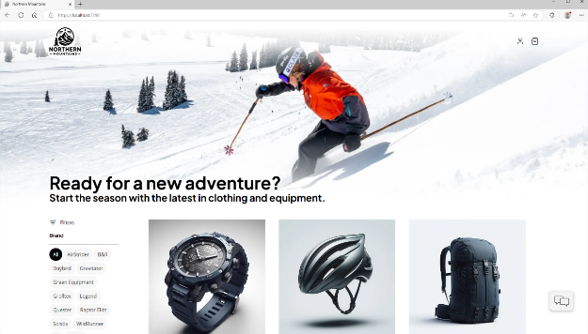


AI Application Architecture Example 2
a
Cloud Services
Client Apps
Identity Service
Mobile BFF
Identity API
PostgreSQL
OpenAI
Mobile App
Catalog Service
Mobile API
Catalog API
PostgreSQL
github.com/dotnet/eshop
github.com/Azure-Samples/ eShopOnAzure
Order Service
Ordering API
Web App
Ordering API
Order Processor
PostgreSQL
Event Bus
Browser
Blazor App
Basket Service
Basket API
Redis
Payment Service
Payment Processor
Admin Services
Webhook Client
Webhooks Service
Observability
Webhooks API
PostgreSQL

Slide 27




AI Application Architecture Example 3
a
1
2
3
4
5
Function app
Upload podcast / view results
REST API for upload and status
User
Static web app
Function (HTTP triggered)
Function (Blob triggered)
Transcribe audio file
Function (Blob triggered)
Generate synopsis, tag line, SEO keywords
https://learn.microsoft.com/azure/architecture/ai-ml/idea/process-audio-files
Save audio file to Azure Storage
Azure AI Services
Azure OpenAI GPT
Speech to text
Storage
raw-files container
transcription container
open-ai-results container

Slide 28


Top use cases
Apps
Data
AI
Connected smart products
Personalization &
recommendations
External customer-facing apps
Service & support
Build your own copilot
Plugins
Information & product discovery
Internal business-critical apps
Transaction processing
at scale
Fraud detection
Azure Kubernetes Service
Azure App Service
Azure SQL DB
Azure AI Services
(including Azure OpenAI Service)
Azure Container Apps
Azure Cosmos DB
Azure DB for PostgreSQL
Azure Machine Learning

Slide 29












Azure API Management
Developer portal
API
Discover
Learn
Try
Onboard
Get help
Abstract and decouple
Secure and protect
Revise and version
Monitor and measure
Publish and monetize
App
developers
Management plane
API
providers
User plane
Gateway
Data plane
Apps
on devices
(micro)services

Slide 30
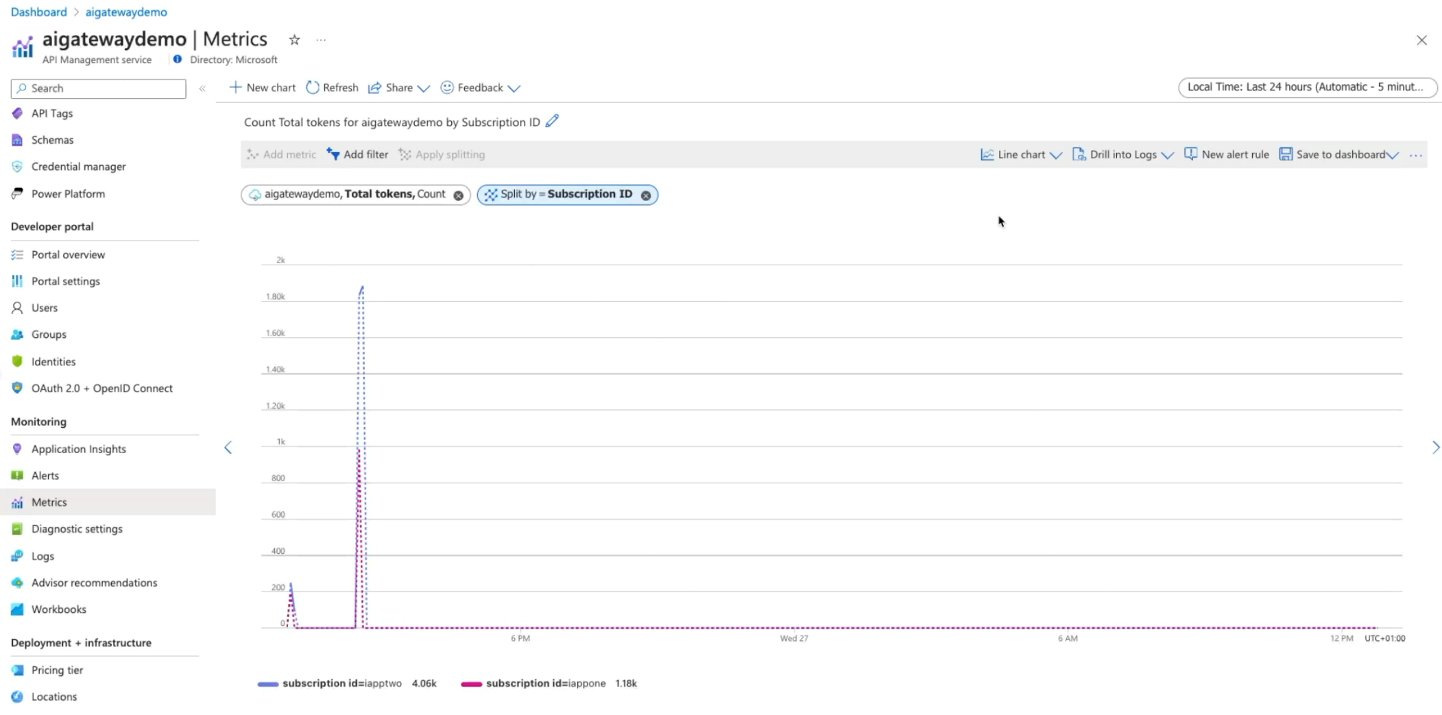

GenAI gateway features in Azure API Management
GenAI Gateway with Azure API Management
Centralize management of model and prompt endpoints
Load balance across OpenAI endpoints, PTU/PAYG, and different models
Track token consumption and attribution for streaming and non-streaming requests
Improve performance and conserve tokens with semantic caching
Secure access to models with Managed Identity
Public preview
Guide: https://aka.ms/genai-gateway
Landing zone accelerator: https://aka.ms/apim-genai-lza

Slide 31
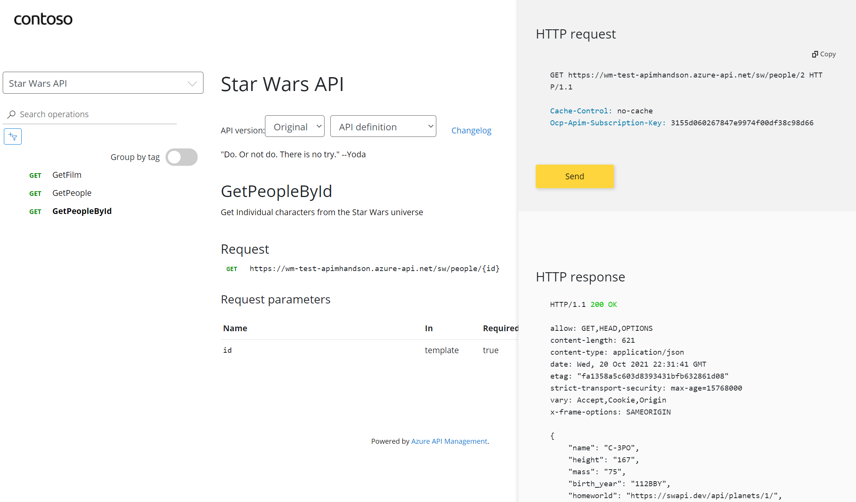
Developer Portal

Slide 32
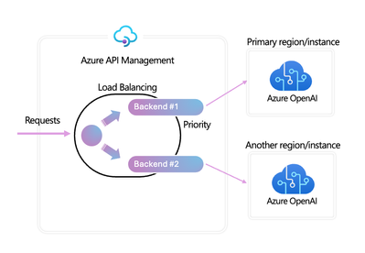
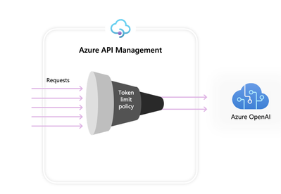
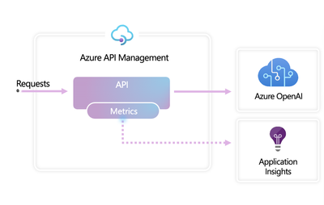
GenAI gateway features in Azure API Management
Load Balancer and Circuit Breaker
Azure OpenAI Token Limit policy
Azure OpenAI Token Metric policy
Distribute requests across PTU and Pay-as-you-go instances
Configure tokens per minute (TPM) limits based on counter keys
Facilitate accurate cross-charging based on token consumption
Define load balancing pools to include multiple Azure OpenAI endpoints
Define similarity score threshold for caching
Collect token usage data
policy.xml
policy.xml
Configure circuit breaker rules for successful failover
<azure-openai-token-limit
counter-key="@(context.Subscription.Id)" tokens-per-minute="1000"
estimate-prompt-tokens="false" />
<azure-openai-emit-token-metric
namespace="AzureOpenAI">
<dimension name="User ID" />
<dimension name="Subscription ID" />
</azure-openai-emit-token-metric>
https://github.com/Azure-Samples/AI-Gateway

Slide 33
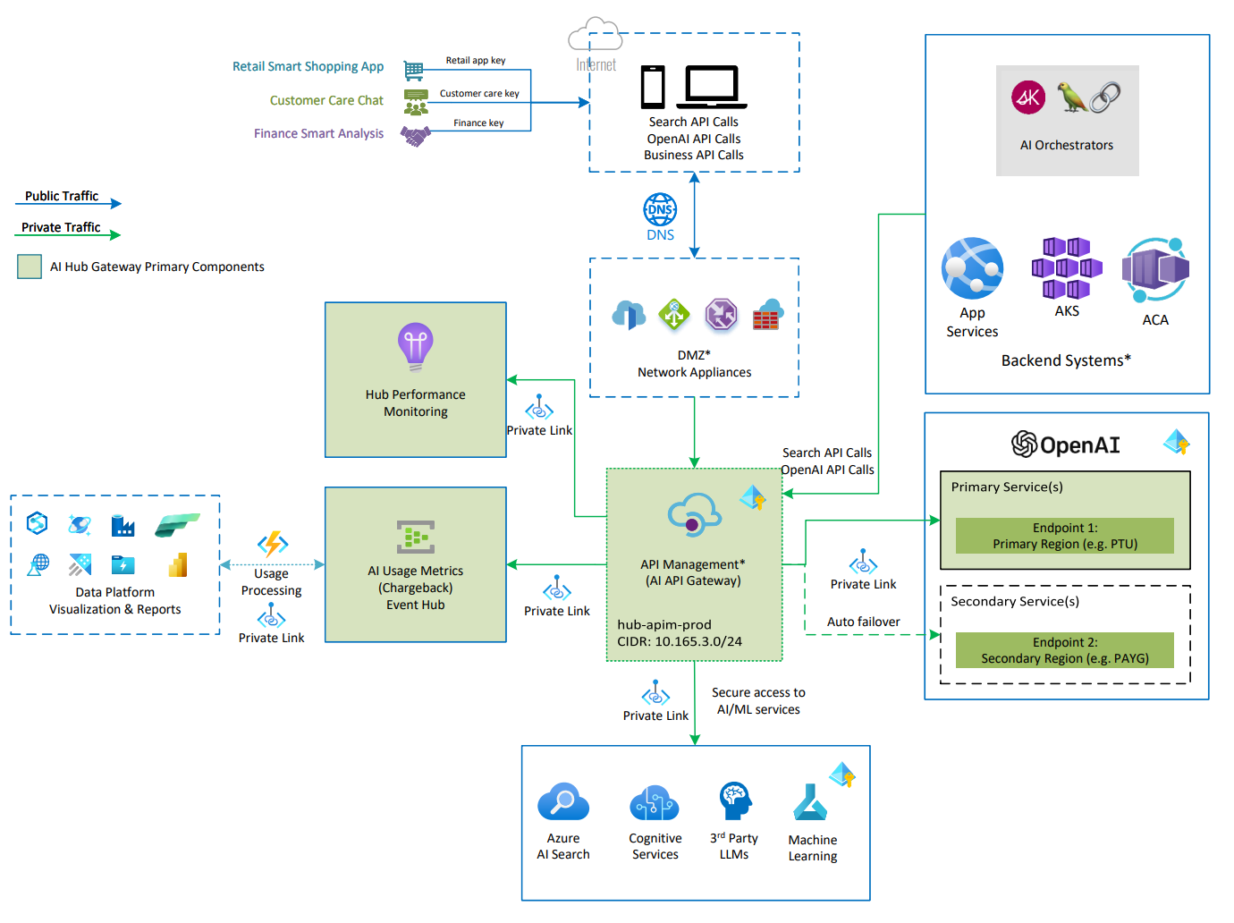
AI Hub Gateway Landing Zone accelerator
https://github.com/Azure-Samples/ai-hub-gateway-solution-accelerator

Slide 34
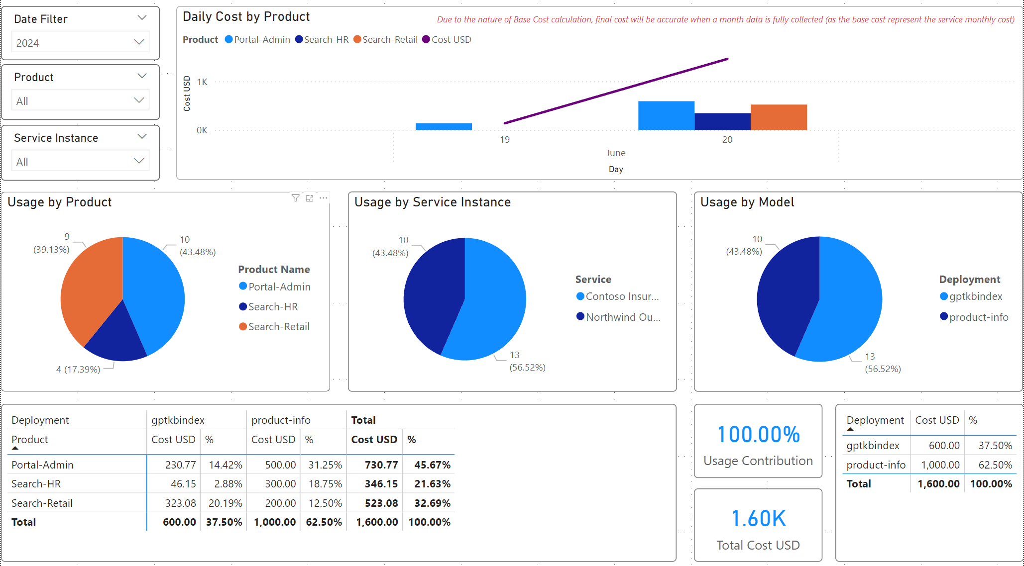
Calculating Chargeback for BU/Projects
https://github.com/Azure-Samples/ai-hub-gateway-solution-accelerator

Slide 35
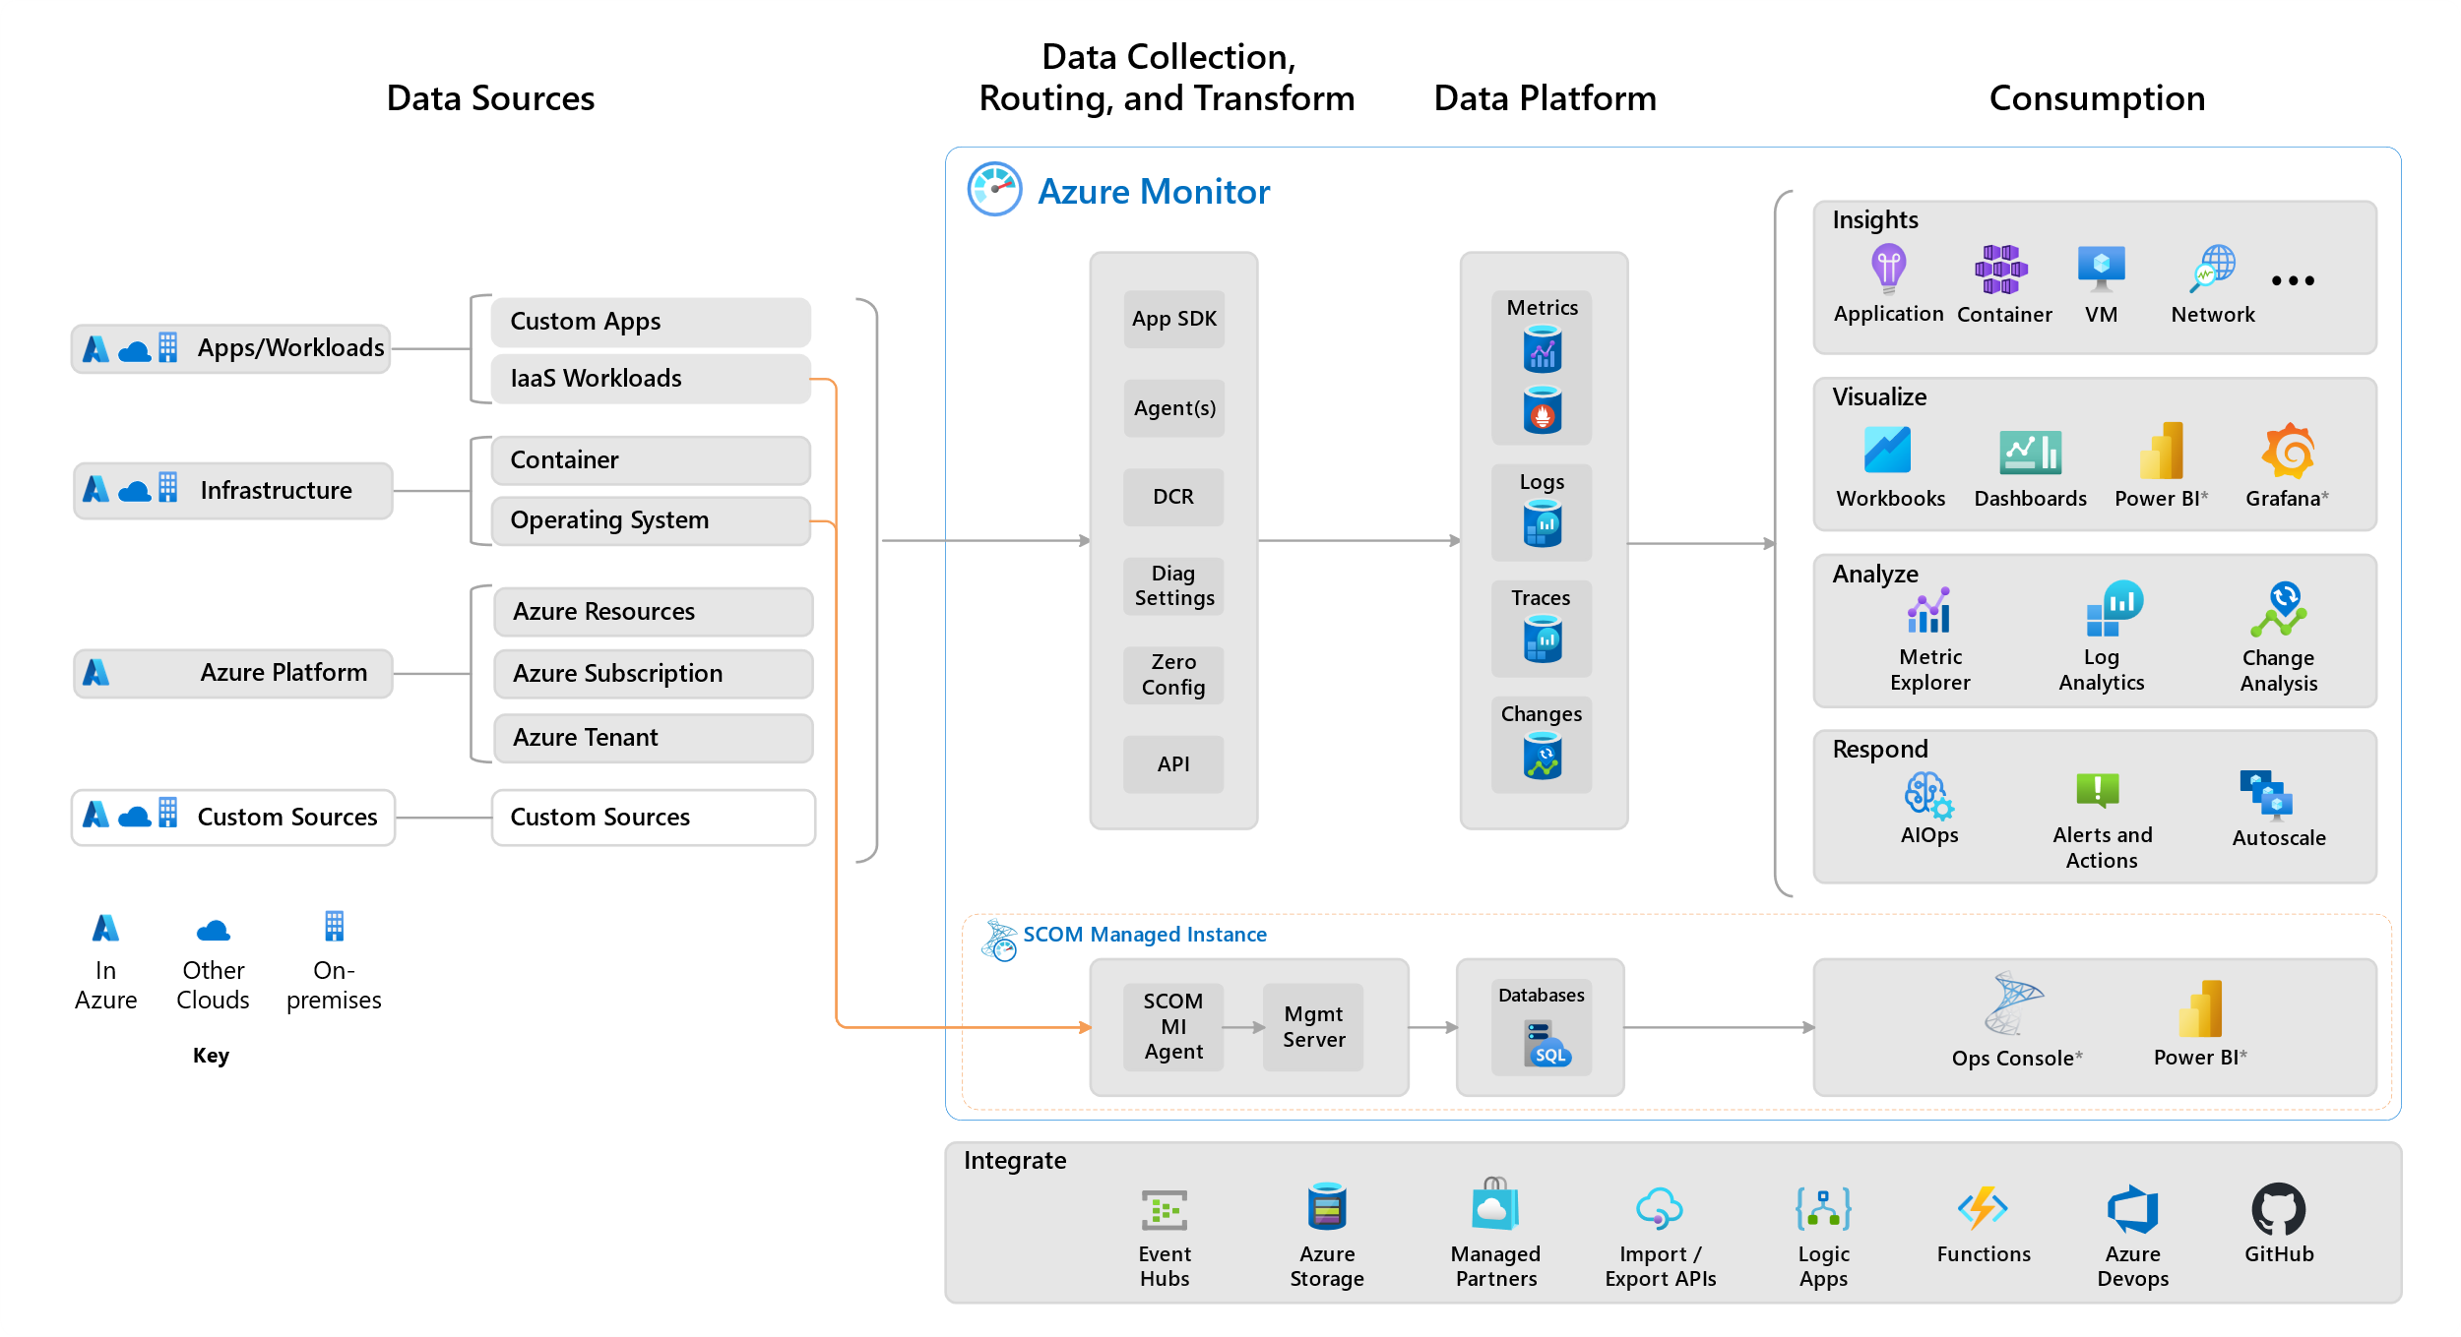
Azure Monitor
https://learn.microsoft.com/en-us/azure/azure-monitor/overview

Slide 36
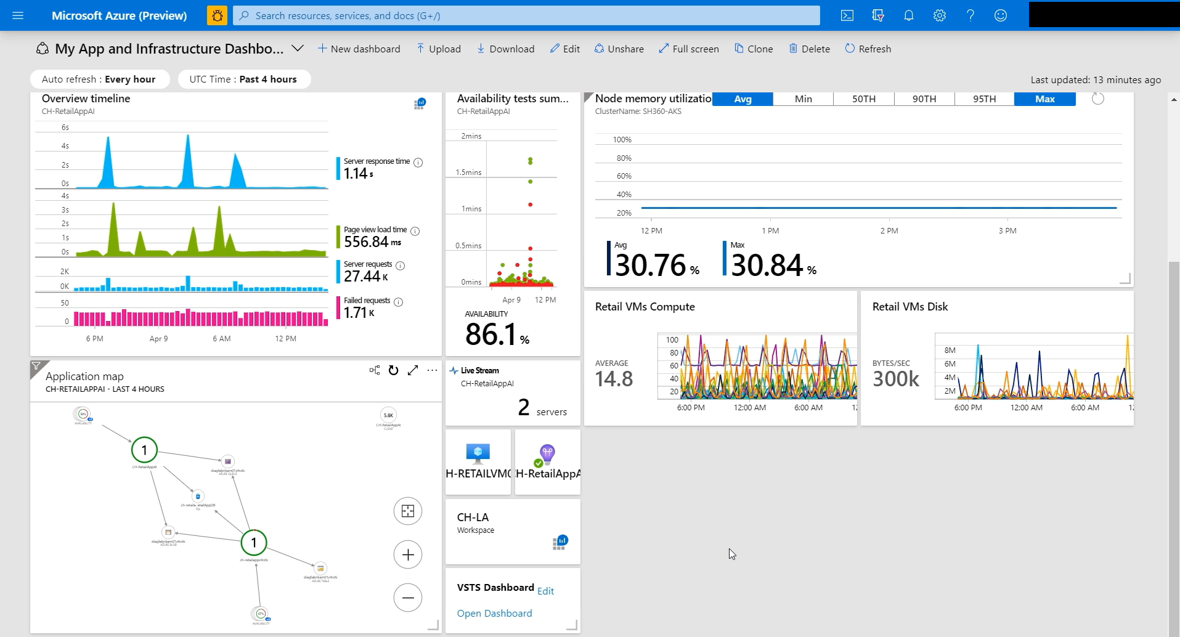

Slide 37
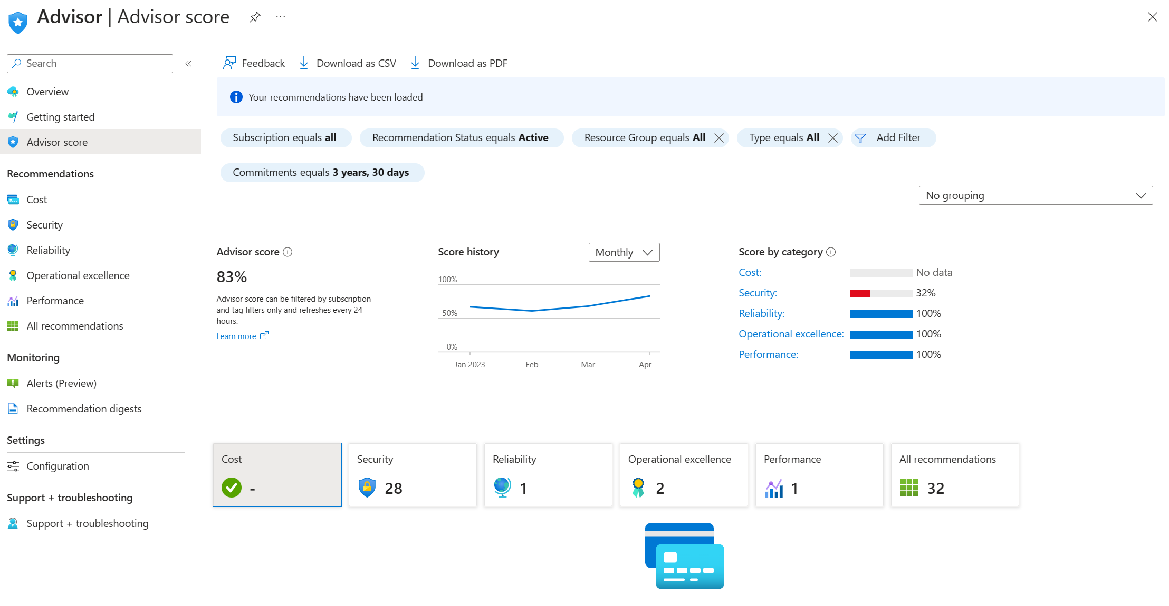

Slide 38
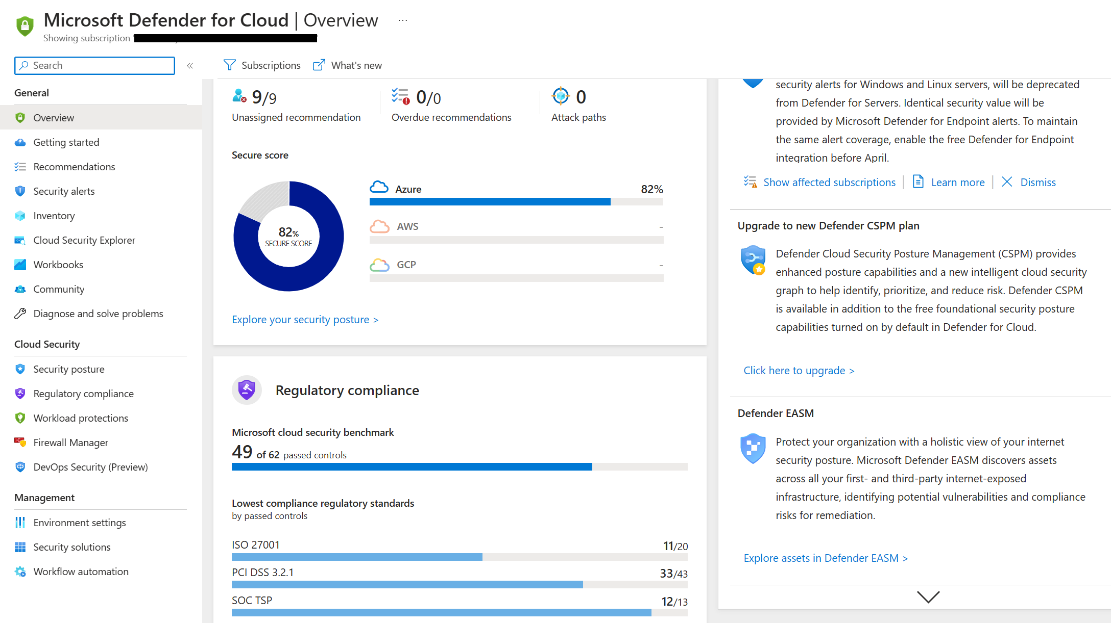

Slide 39

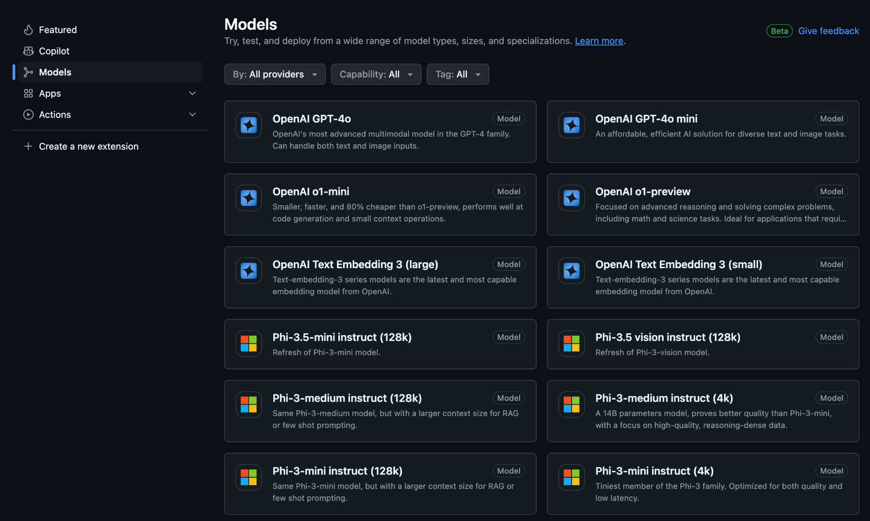
GitHub Models
http://gh.io/models

Slide 40
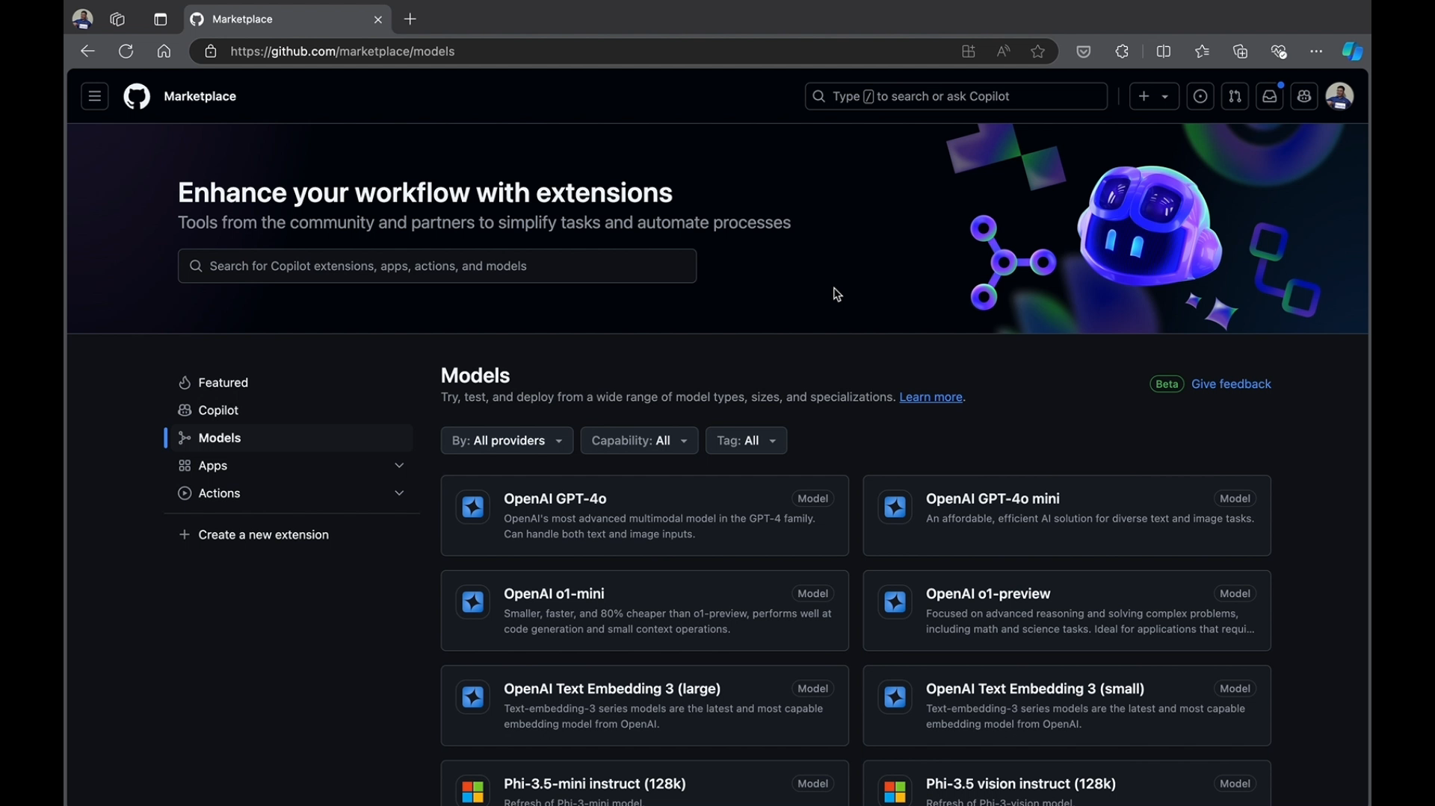

Slide 41

Accelerate Announcements
AI-Powered Code Suggestions
Copilot for Xcode: AI-powered code completion in Xcode, helping Apple developers accelerate development.
Oct. 29
Public Preview
PAIN POINTS:
Developers often spend too much time on repetitive or boilerplate code, slowing down the overall development cycle.
Constantly shifting between different tools or windows breaks the flow, reducing developer efficiency and focus.
Maintaining high code standards can be difficult, especially when coding at speed, leading to potential errors or inconsistencies.
GitHub Copilot in Windows Terminal: Bring AI powered assistance to your command-line window​. Enhance productivity and streamline development by accessing Copilot Chat directly within Windows Terminal.
Oct. 29
Public Preview
Multi-model: Experiment with AI models in Copilot Chat, including OpenAI o1, Claude, and Gemini within GitHub Copilot.
Oct. 29
Public Preview
Code Completion and Chat Quality Improvements: Enhanced code completions and chat assistance with code-specific models, reducing hallucination in the IDE.
Oct. 29
Various Releases
Uplevel the IDE experience: AI-powered features for debugging, personalization with custom instructions, and more to elevate the IDE experience, which supports modernizing and refactoring code.
Oct. 29
Various Releases
Copilot Extensions: Extend GitHub Copilot with tools to enhance coding experience and productivity.
Dec 2024
GA Announcement

Slide 42

Accelerate Announcements
AI for DevSecOps
Code referencing: AI suggestions matching public code with licensing and attribution transparency, supporting security in development workflows.
PAIN POINTS:
Traditional methods of detecting security vulnerabilities are often slow, which can lead to potential risks going unnoticed.
Developers may hesitate to adopt AI solutions due to a lack of visibility into how suggestions are made and whether the code is secure.
Ensuring code meets security and licensing requirements can be challenging, leading to potential risks in code provenance or compliance.
Sept. 30
GA
Copilot Extensions: Extend GitHub Copilot with tools to enhance coding experience and productivity.
Dec 2024
GA Announcement

Slide 43
Accelerate Announcements
Application Migration/Modernization
Upgrade assistant for Java: AI helps modernize Java applications by automating upgrades.
PAIN POINTS:
Developers face significant difficulty in upgrading and migrating legacy code without introducing errors or inconsistencies.
Manually refactoring large or complex codebases is time-consuming and error-prone, slowing down modernization efforts.
Identifying performance bottlenecks in older code is often difficult, and optimizing these inefficiencies can require substantial effort, slowing down development.
Oct. 29
Technical Preview
Code Review (in GitHub): AI-powered code feedback during pull requests, accelerating reviews and enhancing code quality.
Oct. 29
Public Preview
Code review in VS Code: Real-time AI-powered code feedback as you code in VS Code.
Nov. 1
Public Preview
Copilot Workspace: AI-powered development environment transforming natural language into code.
*Includes “Project Hadron”, which will be in Public Preview @ Universe.
Oct. 29
Technical Preview
Uplevel the IDE experience: AI-powered features for debugging, personalization with custom instructions, and more to elevate the IDE experience, which supports modernizing and refactoring code.
Oct. 29
Various Releases
Copilot Extensions: Extend GitHub Copilot with tools to enhance coding experience and productivity.
Dec 2024
GA Announcement

Slide 44








Microsoft provides a unified solution to help you accelerate and secure code-to-cloud development
Dev
Visual Studio Code
Azure Repos
Azure Pipelines
GitHub Advanced Security
Container Scanning
Code scanning
Secret scanning
Dependency review
GitHub Repos
GitHub Actions
Azure Container Registry
Azure
Codespaces
IaC Scanning
Microsoft Defender for Cloud
Defender for DevOps
DevOps Security Mgmt.
GitHub & Azure DevOps Connectors
Code to Cloud Context
SecOps
Cloud Security
Posture Management
Threat Protection
Secure Azure Policy
Azure Secure Score
Azure Security Benchmark
WAF / DDoS
Microsoft Sentinel
Azure
AD
App Config
Azure Monitor
Azure Key Vault

Slide 45



















Cloud-native on Azure
Community
Security
AI
Language
Speech
Vision
Decision
Active Directory
Azure Policy
Microsoft Defender
Key Vault
Azure Advisor
OpenAI
Development tools
Cloud-native application platform
Managed databases
GitHub
Azure Kubernetes Service
Azure Red Hat OpenShift
Azure Container Apps
Azure Functions
Azure PostgreSQL
Azure Cosmos DB
Azure SQL family
Azure MySQL & MariaDB
Visual Studio Code
Azure API Management
Azure Container Registry
Cloud operations anywhere
Azure Arc

Slide 46
Thank you

